Slide 1
Time Log Tracker Project
Group D > Mahesh Doiphode > JABU Aishwarya > Ganesh Raut > Omkar Wakale > Ankit Dixit > GUDDU KUMAR

Slide 2
PROJECT DESCRIPTION
Problem statement
Project managers struggle with time-consuming administrative tasks as they grapple with retrieving essential data from Excel-based time log activities to stay compliant with Human Resource regulations.
Project Objective
Develop an application to facilitate easy access, retrieval, and readable presentation of time log details with filters, addressing the challenge outlined in the problem statement for both individual employees and groups.

Slide 3
Features Required
Data Generation and Upload
User-Friendly Interface
Detailed Individual Records
Activity-Based Reporting
Visual Representation with Charts
Efficiency and Time Savings
Security Measures
Future Enhancements

Slide 4
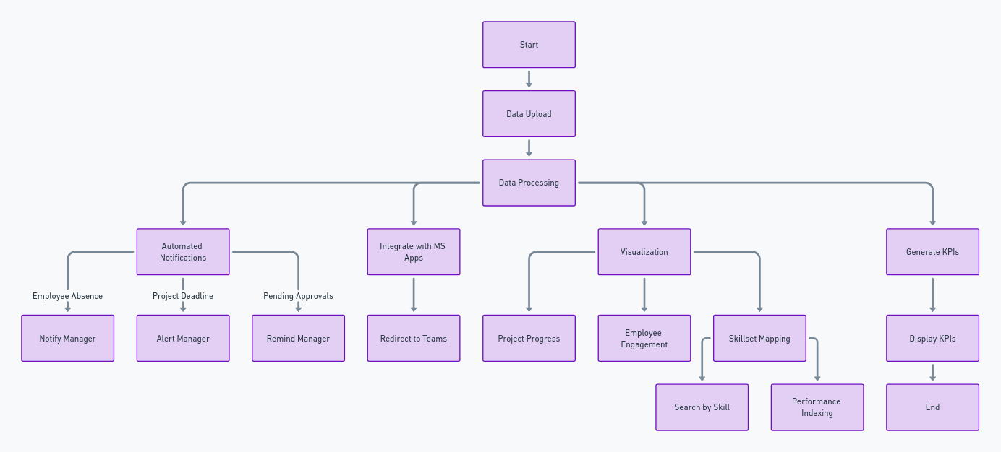
FLOWCHART

Slide 5
REQUIREMENTS
Manager: Uploads data, requests employee data, generates KPIs, sends notifications.
Employee: Fetches and sends their data.
Timelog System: Acts as an intermediary, processes requests, and delivers data.
Data Flow: Shows how data is uploaded, processed, and displayed.
Outcome: Helps monitor performance, aids in skillset mapping, and sends automated notifications.

Slide 6
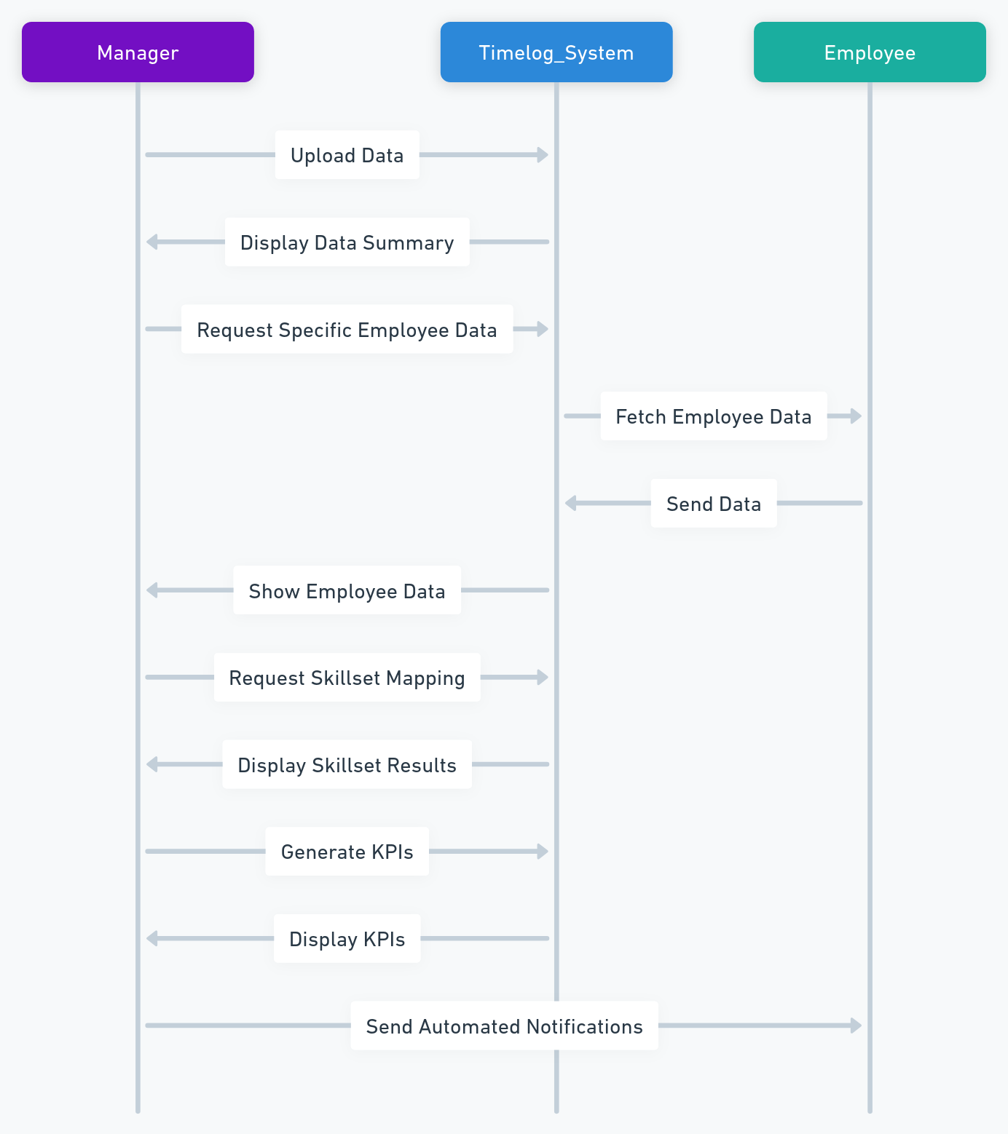

Slide 7
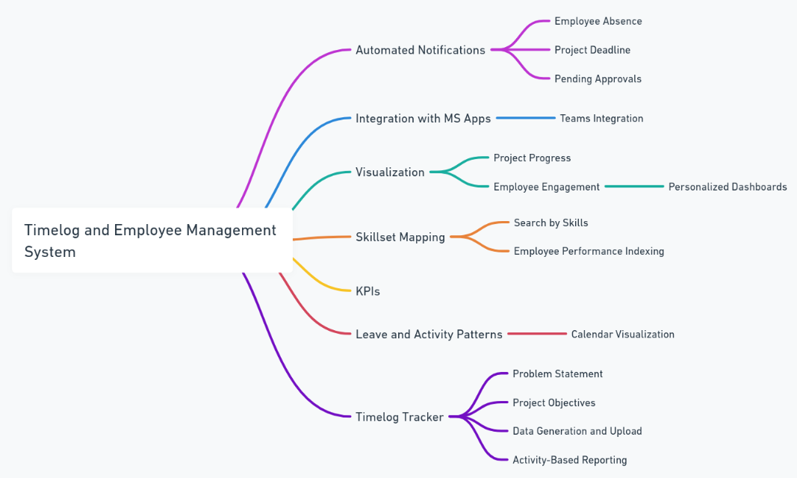

Slide 8
THANK YOU

